Slide 1

Building Control Algorithm for State Space Search
SCJ3553
Artificial Intelligence
Faculty of Computer Science and Information Systems
Universiti Teknologi Malaysia

Slide 2
Outline
Recursion-based system
Production Systems
Control of Search in Production System
Blackboard architecture

Slide 3
Recursion-based system
Important tool for programming graph search
A recursive procedure consists of:
  Recursive step-procedure calls itself
  Terminating condition that stops the procedure from recurring endlessly
A natural control construct for data structures
  i.e. lists, trees and graph

Slide 4
Recursion-based system
Pattern-based Searching Technique
  major advantage of using general methods such as unification and modus ponens to generate states is the resulting algorithm may search any space of logical inferences.
  The specifics of a problem are described using predicate calculus assertions.
  Thus, we have a means of separating problem-solving knowledge from its control and implementation.
  One example of implementation of the separation of knowledge and control is pattern-search.

Slide 5
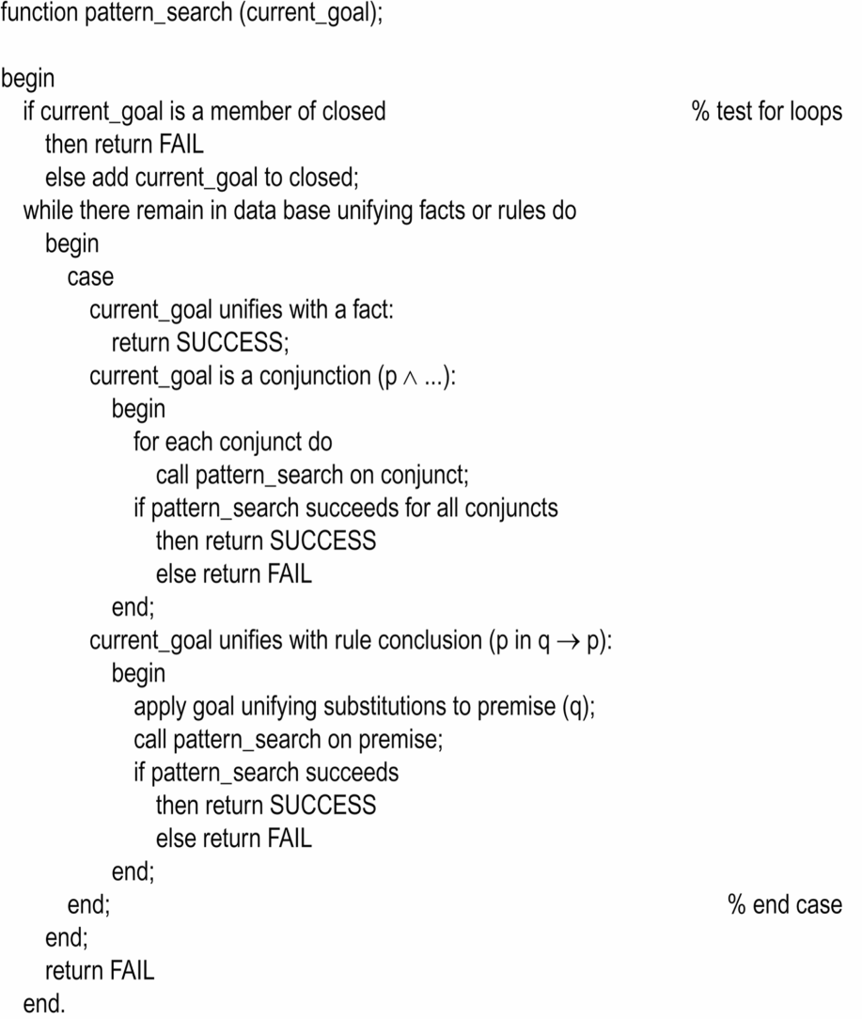
Recursion-based system
Pattern-based Searching Technique
Recursive search is applied to a space of logical inferences
result in a general search procedure for predicate calculus based problem specifications
eg. In goal-directed search, modus ponens define the transition between states.
  i.e. a goal p(a), the algorithm uses UNIFICATION to select the implications whose conclusions match the goal (q(x) -> p(x))
  Implications are simply called rules
  After unification, rule premise becomes new subgoal q(a)
  The algo recurs on the subgoal
  If subgoal matches fact in KB, search terminates

Slide 6
Production Systems
Alternative control structure for pattern-directed search
Model of computation in implementing search algorithm and modeling human problem solving
Provides pattern-directed control of a problem-solving process
Consists of a set of production rules, working memory and recognise-act control cycle.
Architecture for knowledge-based systems

Slide 7
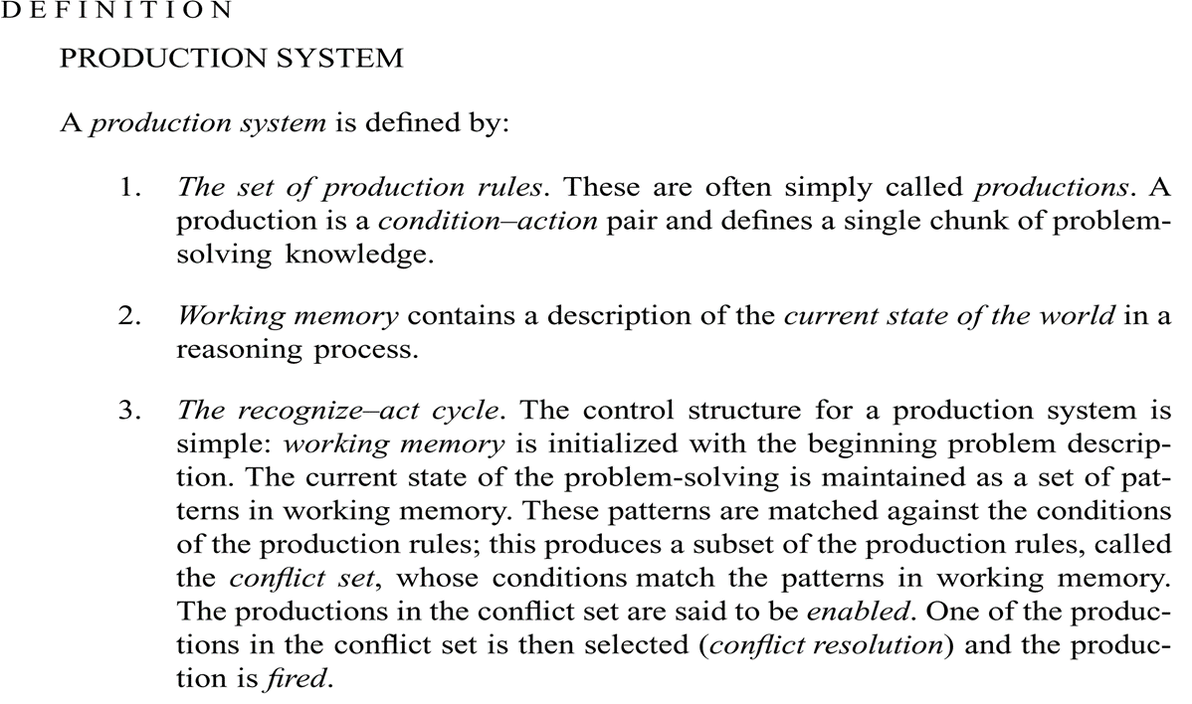
Production Systems

Slide 8
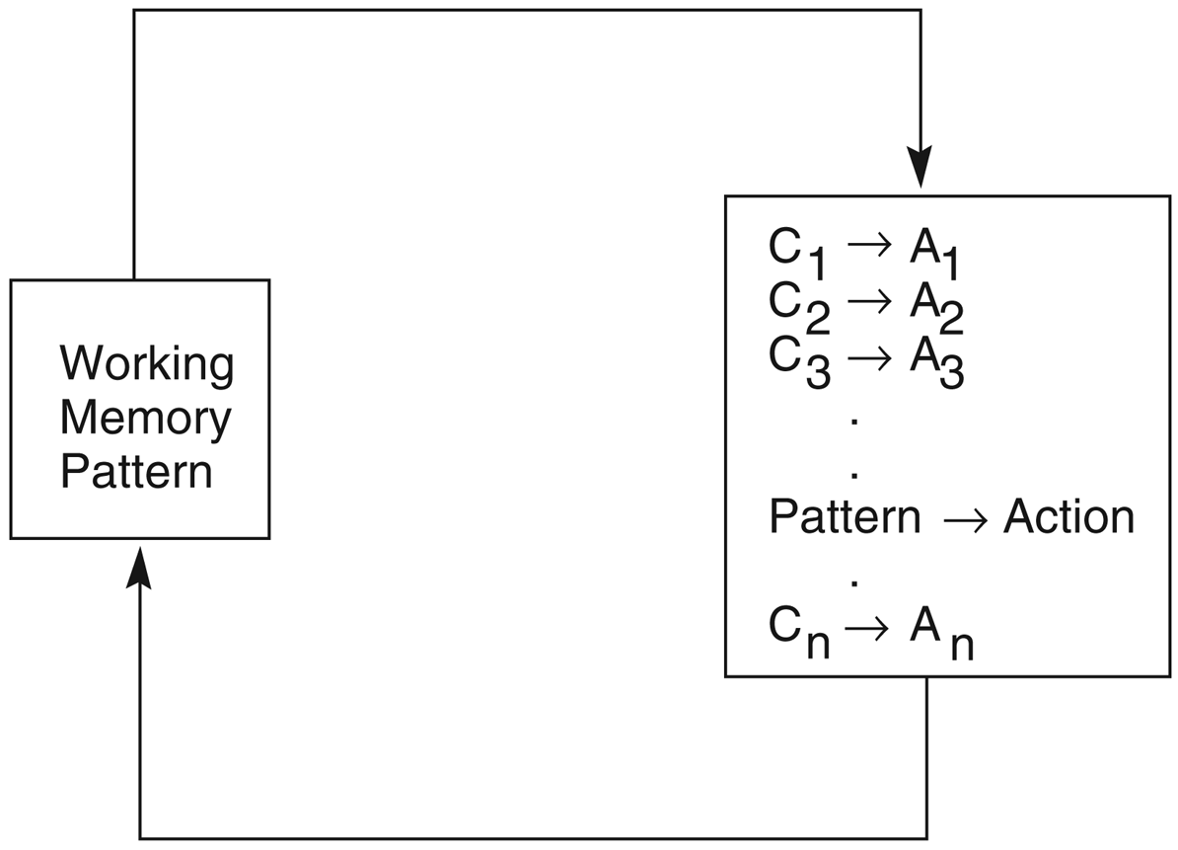
Production Systems
A production system. Control loops until working memory pattern
no longer matches the conditions of any productions.

Slide 9
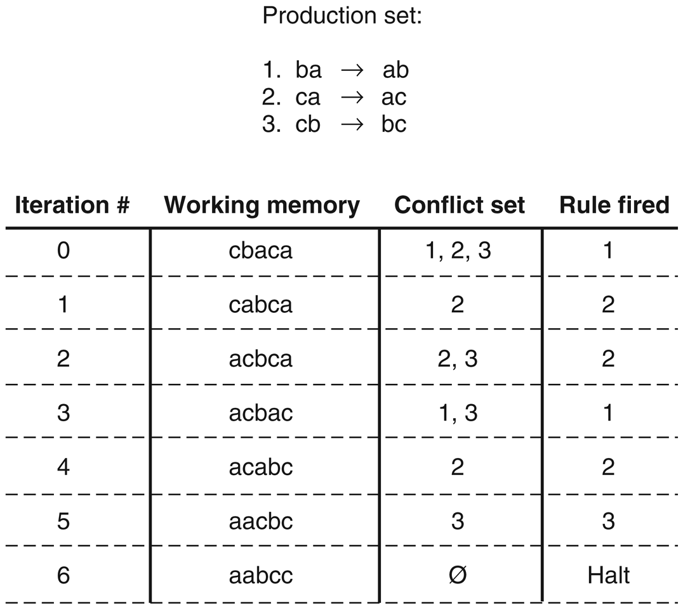
Production Systems
eg: A production system program for sorting a string composed of letters a, b and c
A production is enabled if its condition matches part of string in working memory.
When a rule is fired, the substring that matched the rule condition is replaced by the string on the right-hand side of the rule.
Productions are invoked by the ‘pattern’ of a particular problem instances

Slide 10
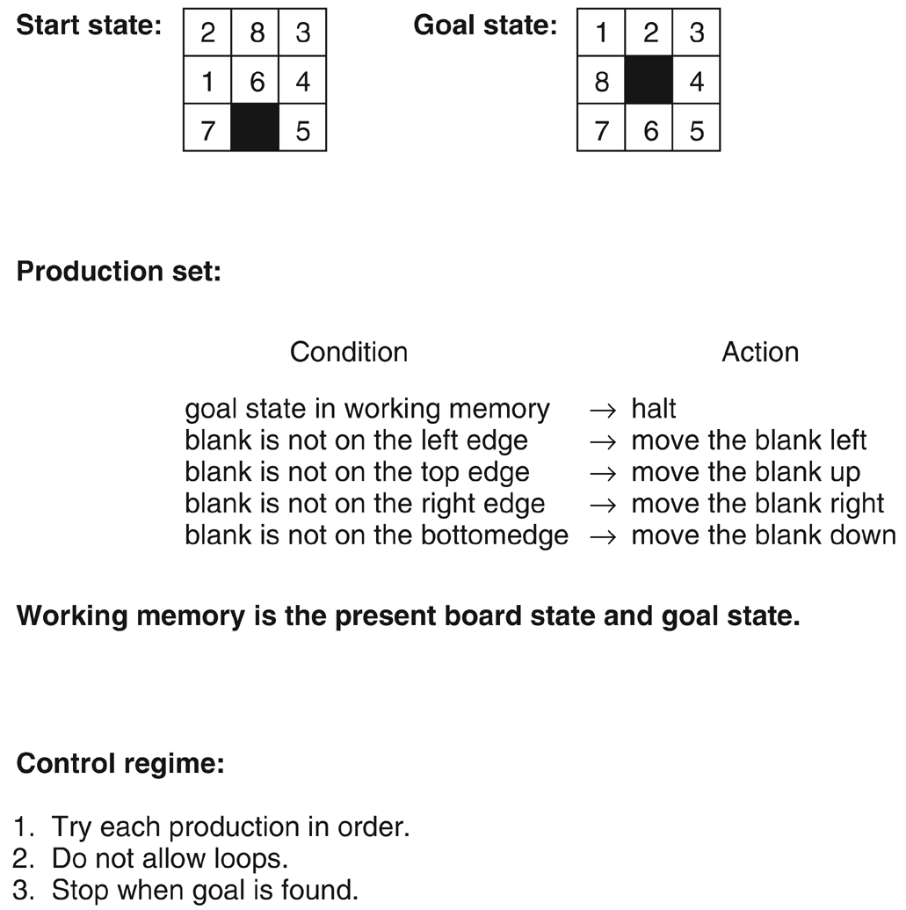
Production Systems

Slide 11
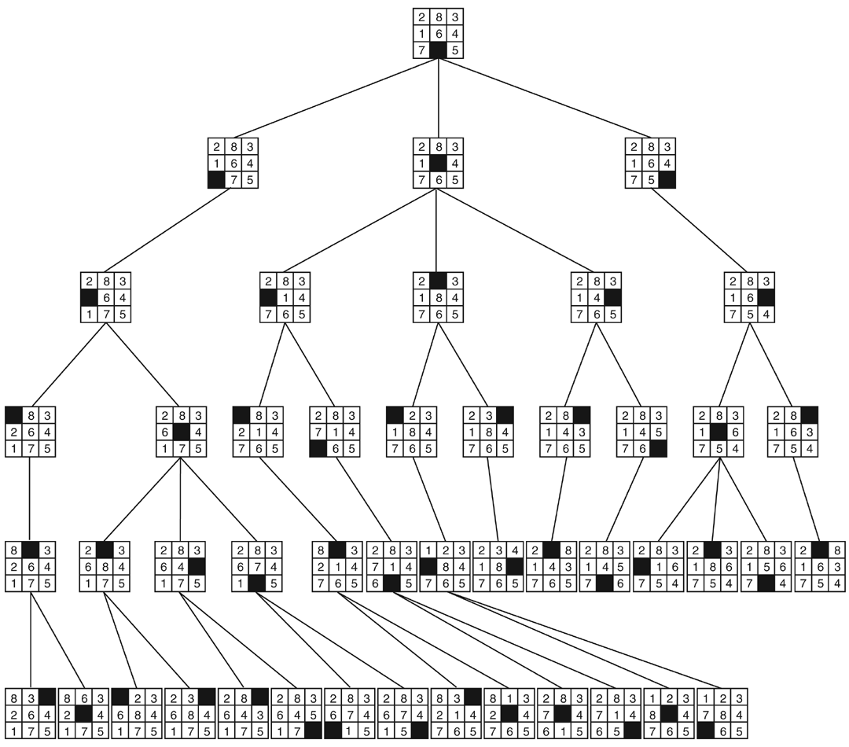
Production Systems

Slide 12
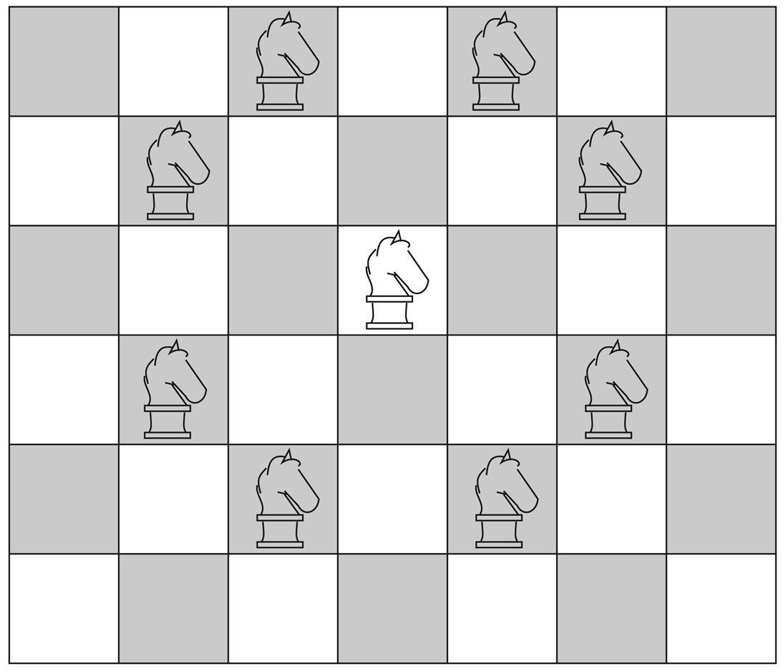
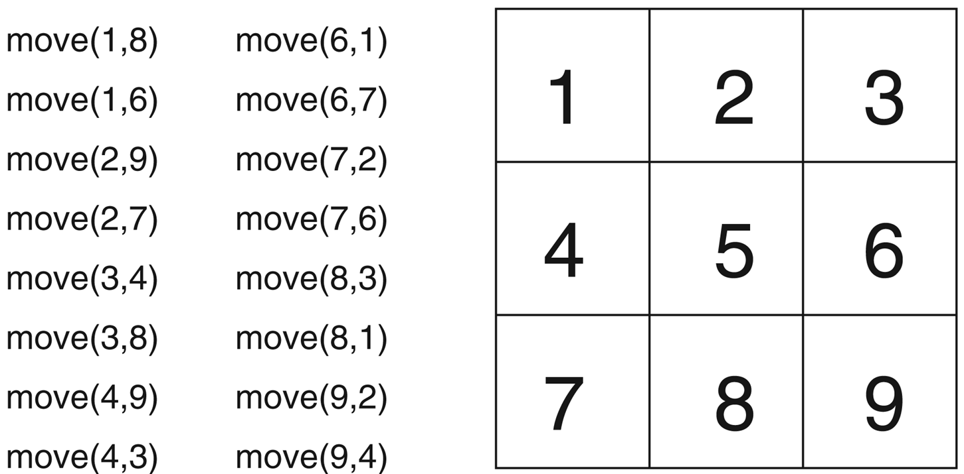
Production Systems

Slide 13
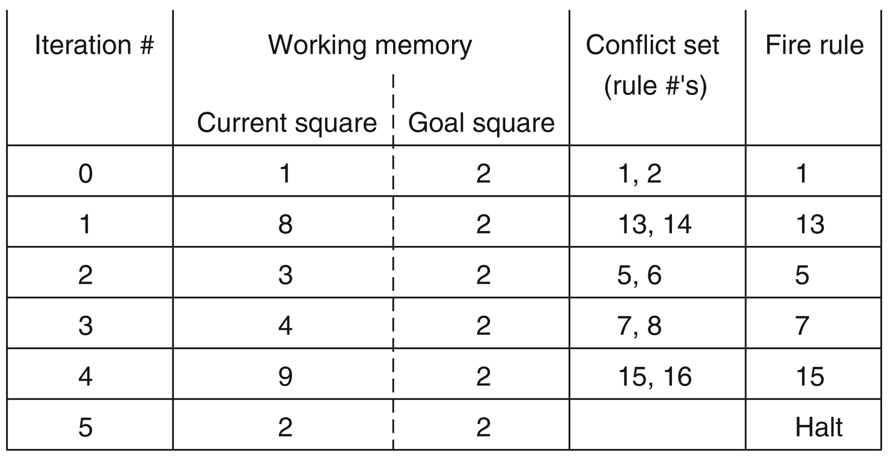
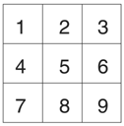
Production Systems
A production system solution to the 3 x 3 knight’s tour problem to make legal move from 1 to 2.
R1
R9
R2
R10
R3
R11
R4
R12
R5
R13
R6
R14
R7
R15
R8
R16

Slide 14
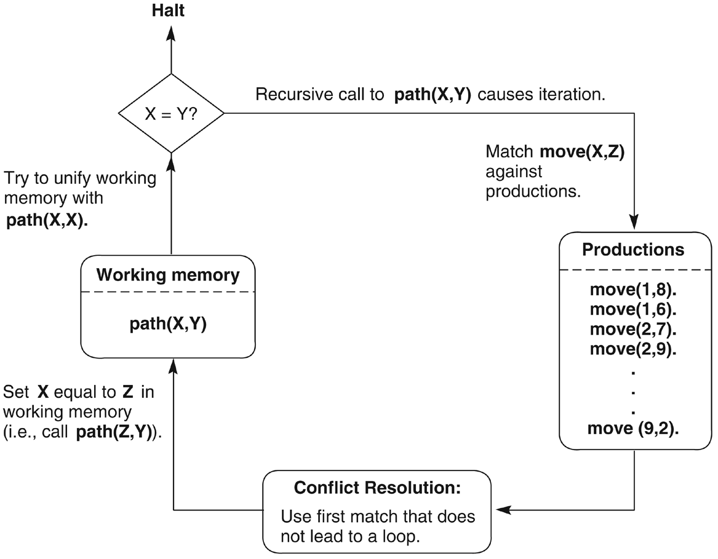
Production Systems

Slide 15
Control of Search in Production System
Production system offers opportunities for adding heuristic control to search algorithm, including:-
  Choice of data-driven or goal-driven strategies
  Structure of rules
  Choice of strategies for conflict resolution

Slide 16
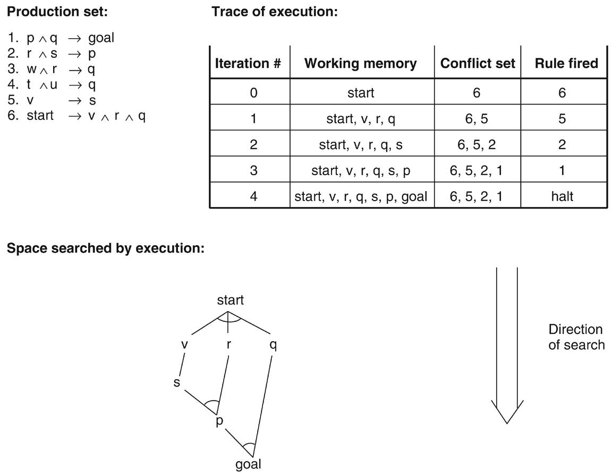
Control of Search in Production System
Data-driven search in a production system
Begin with problem description
Infers new knowledge from data through rules inferencing, legal moves etc.
Continues until goal is reached
Productions have
CONDITION->ACTION form creating new state of graph

Slide 17
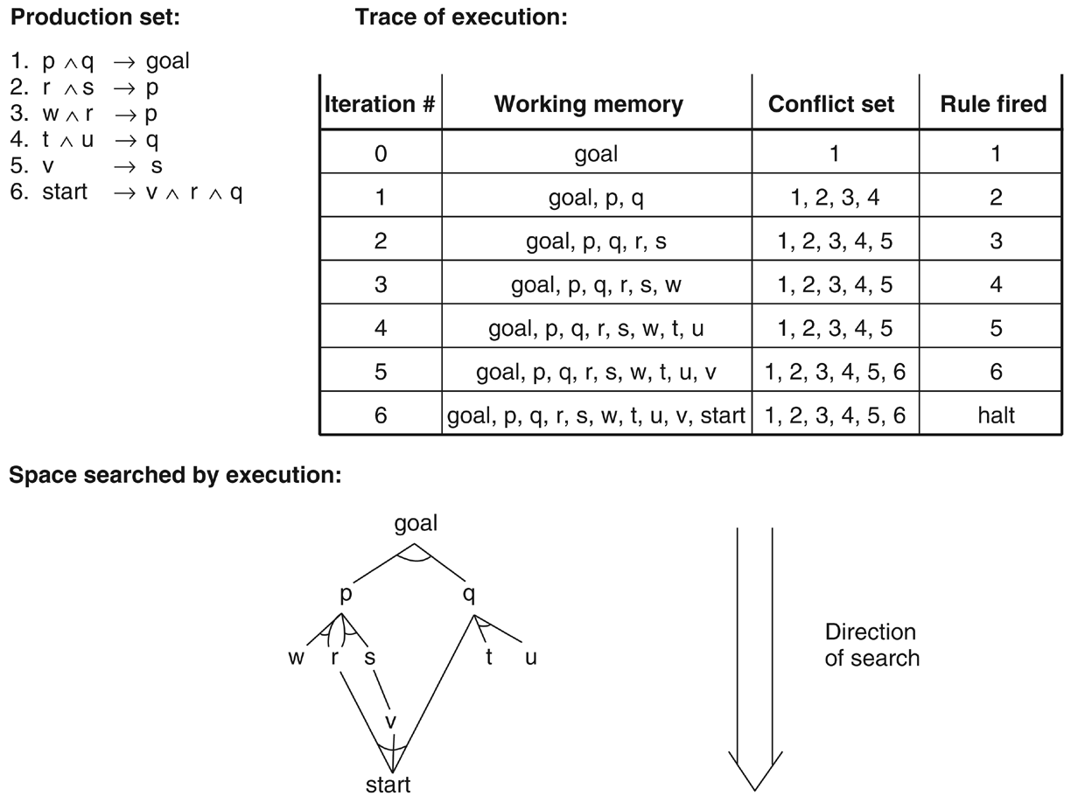
Control of Search in Production System
Goal-driven search in a production system
Begins with a goal, work backward to facts satisfying the goals
In production system,
-Goal is placed in working memory
ACTIONS <- CONDITIONS
Continues until facts are found

Slide 18
Control of Search in Production System
Structure of rules :-
  programmer may control search through the structure (distinction between condition and action) and order of rules in production set.
  order of premises encodes important procedural information

Slide 19
Control of Search in Production System
Heuristic control through conflict resolution
  i.e. choose first rule matches the working memory
  By Brownston et al. 1985
    Refraction – once a rule has fired, it may not fire again until working memory element that match its condition have been modified to discourage looping
    Recency – choose rules whose condition match with the pattern most recently added to the working memory
    Specificity – use a more specific problem-solving rule rather than general one

Slide 20
Control of Search in Production System
Major advantages of production systems for artificial intelligence
i) Separation of Knowledge and Control- control (recognize-act cyle) and knowledge in the rule, can maintain separately
ii) A Natural Mapping onto State Space Search- working memory = nodes of states, production rules=transitions between states, conflict resolution=branch
iii) Modularity of Production Rules –syntatic independence, easy adding, deleting or changing knowledge of system
iv) Pattern-Directed Control
v) Opportunities for Heuristic Control of Search

Slide 21
Blackboard Architecture
Extends production systems by allowing organizing production memory into separate modules, each correspond to different set of rules
Blackboard integrate separate sets of rules and coordinate the actions of multiple agents (knowledge source -KS) within a single global structure , blackboard
i.e. speech understanding program
  First, manipulate utterance represented as digitized waveform
  Then find words in this utterance form a sentence
  Finally, produce semantic repsentation of utterance meaning

Slide 22
Blackboard Architecture
Blackboard architecture – model of control requires coordination of multiple processes or knowledge sources (KS).
Blackboard- a central global database for communication of independent asynchronous knowledge sources focusing on related aspects of particular problem

Slide 23
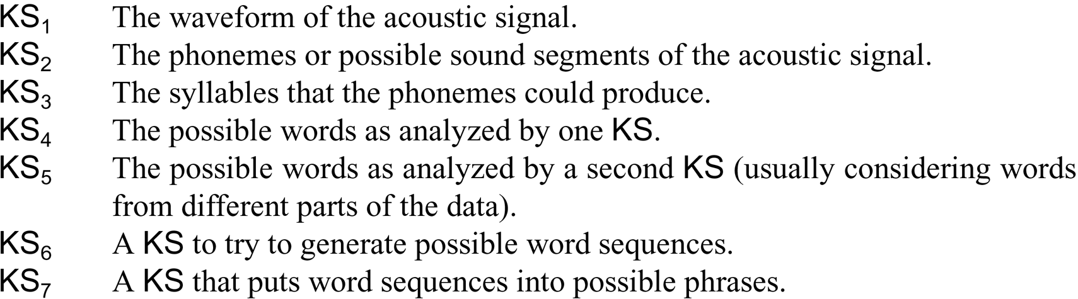
Global blackboard
-waveform is entered at lowest level
-KS for processing this entry is enabled and post interpretation to blackboard, to be picked up by appropriate process
KS₁
Each level of analysis is processed by different class of knowledge source (KS)
KS₂
:
KS_{i}
:
KS_{n}
-all processes are asynchronous and data driven
-they act when they have input data, continue acting until they have finished their task, then post their results and wait for next task

